Slide 1
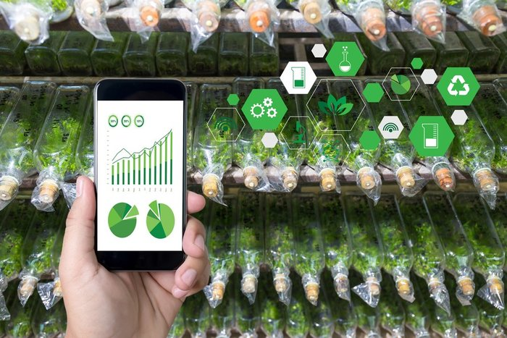

WELCOME TO OUR PRESENTATION
INTRODUCTION
WE GLAD THAT YOU ARE HERE
`

Slide 2
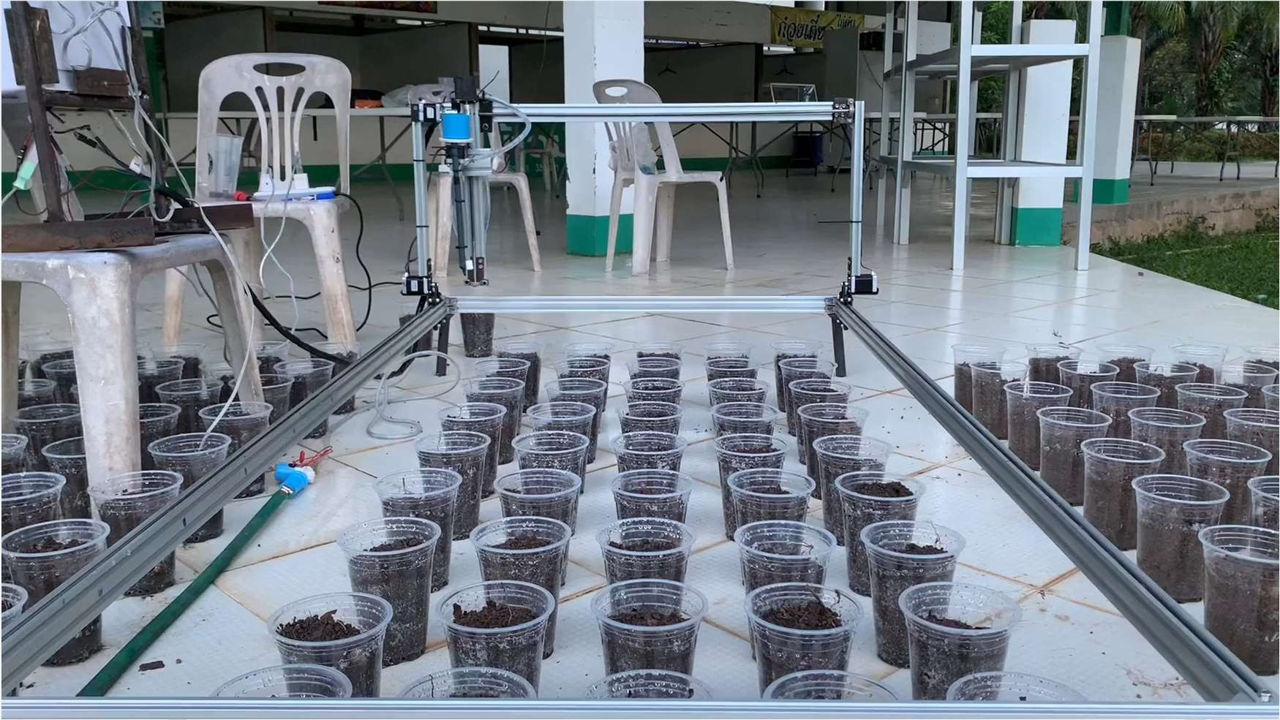

The prototype of the automatic planting and watering system
INTRODUCTION
Advisor: Assoc.Prof.Anchasa Pramuanjaroenkij, PhD

Slide 3



INTRODUCTION
LE THANH HUNG
NGUYUEN CUU SUU
LE QUANG NHAT
Data science and
Artificial Intelligence
Automation and
Control Engineering
Automation and
Control Engineering

Slide 4
1. INTRODUCTION
OUTLINE
2. PROBLEM STATEMENT
3. DEVELOPMENT IDEAS
4. THEORY AND LITERATURE SURVEY
5. EQUIPMENTS AND METHOD
INTRODUCTION
6. RESULT
7. CONCLUSION

Slide 5
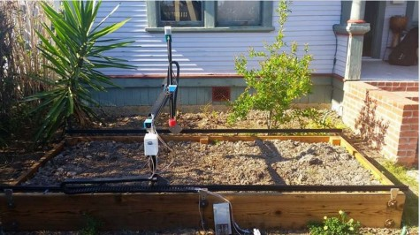
PROBLEM STATEMENT
PROBLEM STATEMENT
What the planter can do and problems

Slide 6
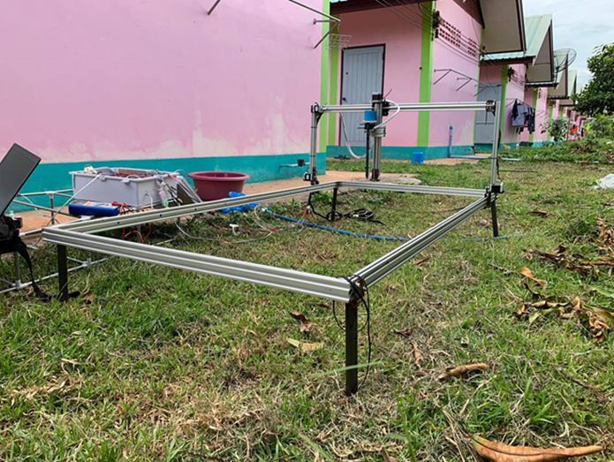
Backlog problem
What the planter
can do ?
It can watering and drop the seeds
It works unstable and quite slow.
PROBLEM STATEMENT

Slide 7
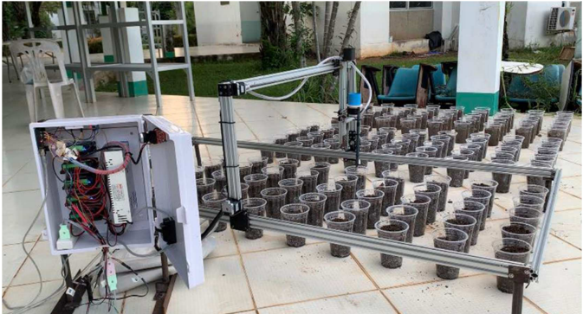
DEVELOPMENT IDEAS
What will we do to develop it ?

Slide 8

AUTOMATICALLY
DEVELOPMENT IDEAS

Slide 9
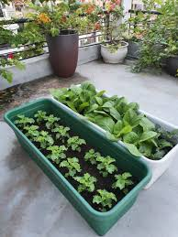
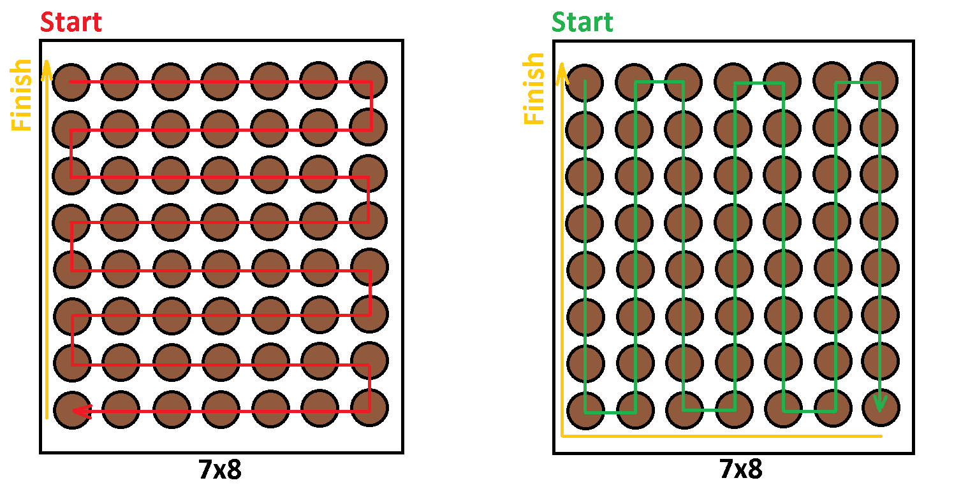
PLANTING MODE
DEVELOPMENT IDEAS

Slide 10
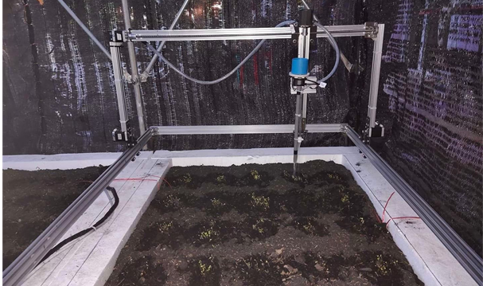
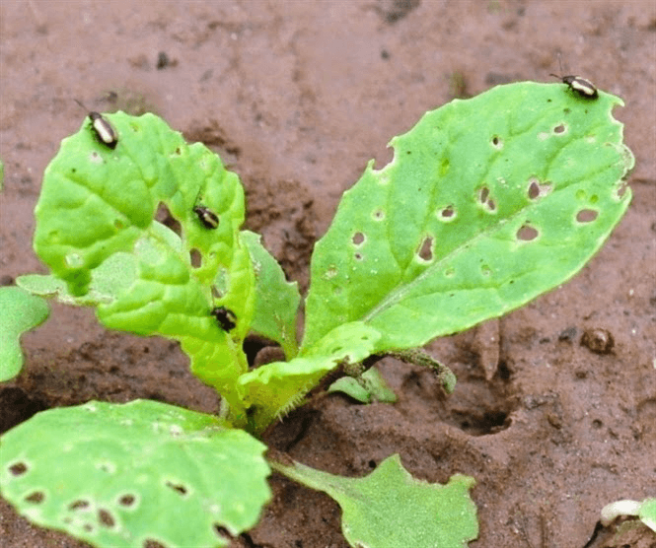
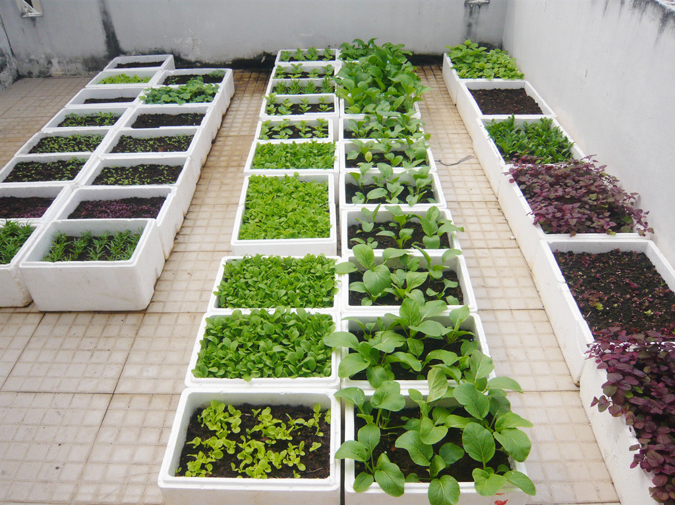
DISEASE PLANT
DEVELOPMENT IDEAS
COUNTING LEAVES

Slide 11

OBJECTIVES
What will we have to do ?
To improve the speed and make it run smoothly.
To set the planting mode
To make it work automatically from an mobile application
To get planting information: humidity, temperature and soil moisture
To detect the unhealthy leaves
To count leaves
DEVELOPMENT IDEAS

Slide 12
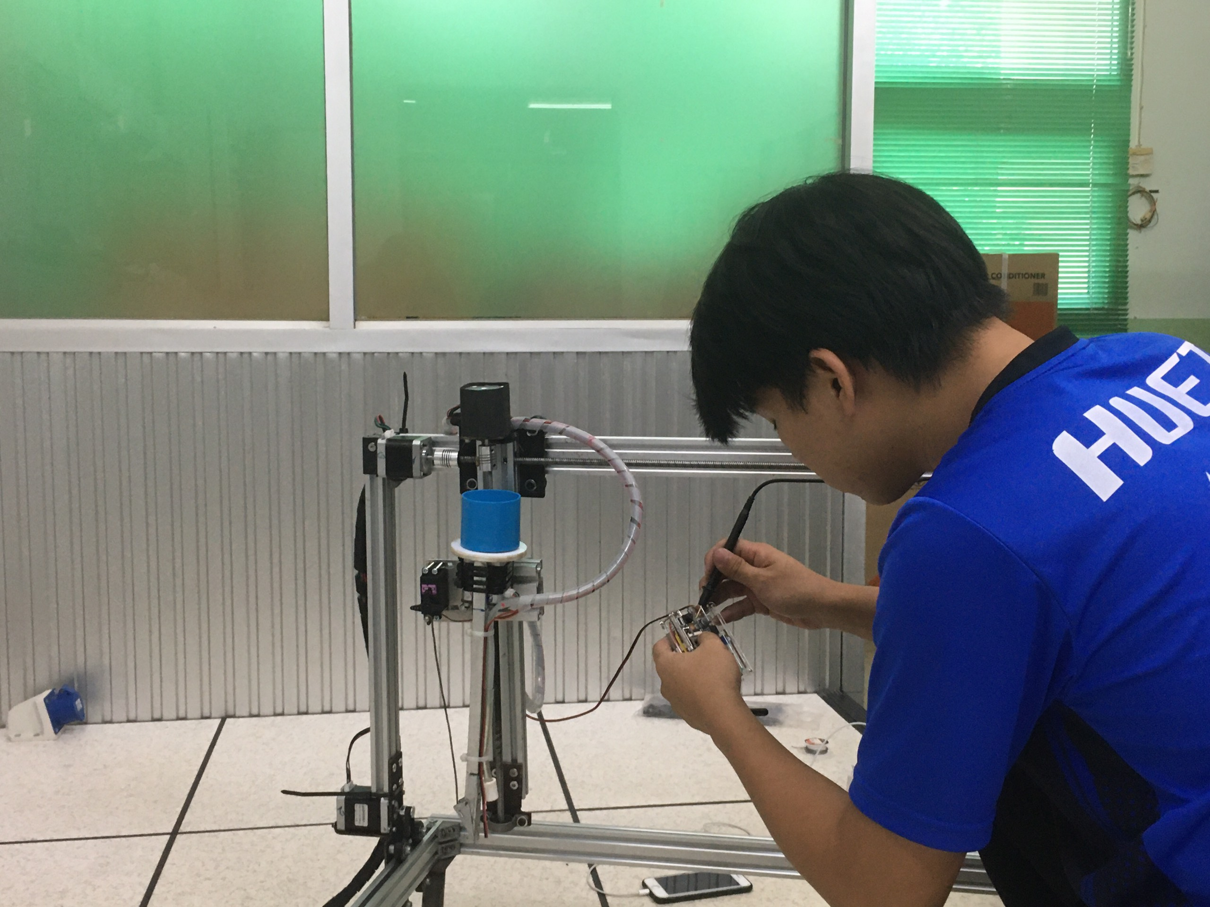
THEORY AND LITERATURE SURVEY
INTRODUCE
THEORY AND LITERATURE SURVEY

Slide 13
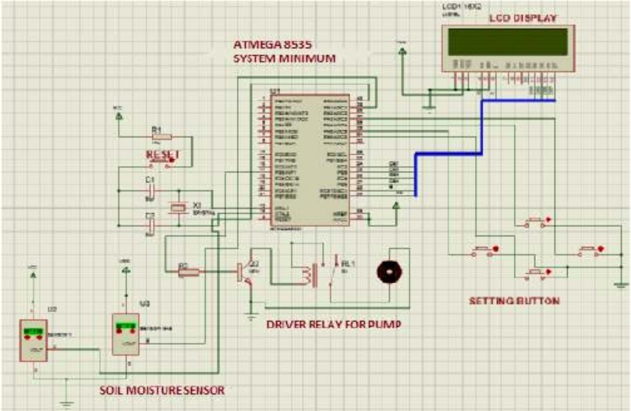
AUTOMATION WATER SYSTEM
The Prototype of Automatic Water Sprinkle with Soil Moisture Sensor Based on ATMega 8535
THEORY AND LITERATURE SURVEY

Slide 14
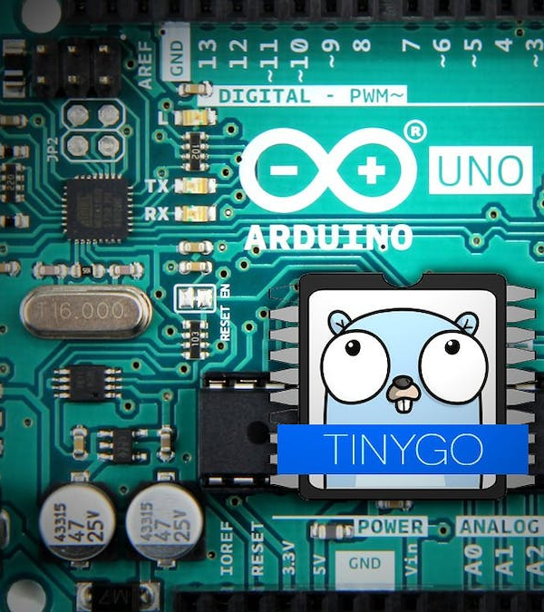

ANDUINO
Ceramic 2 parts:
Microcontrollers (hardware)
IDE (software)
THEORY AND LITERATURE SURVEY

Slide 15
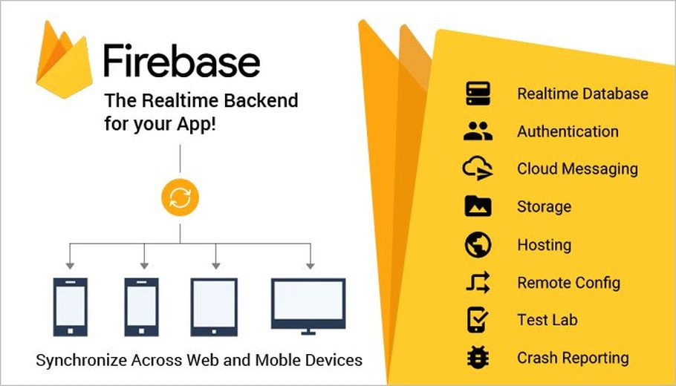

FIREBASE
Why we using this ?
Firebase is a google-owned platform that helps us develop web and mobile applications.
THEORY AND LITERATURE SURVEY

Slide 16


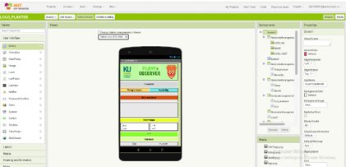
MIT APP INVENTOR
THEORY AND LITERATURE SURVEY

Slide 17
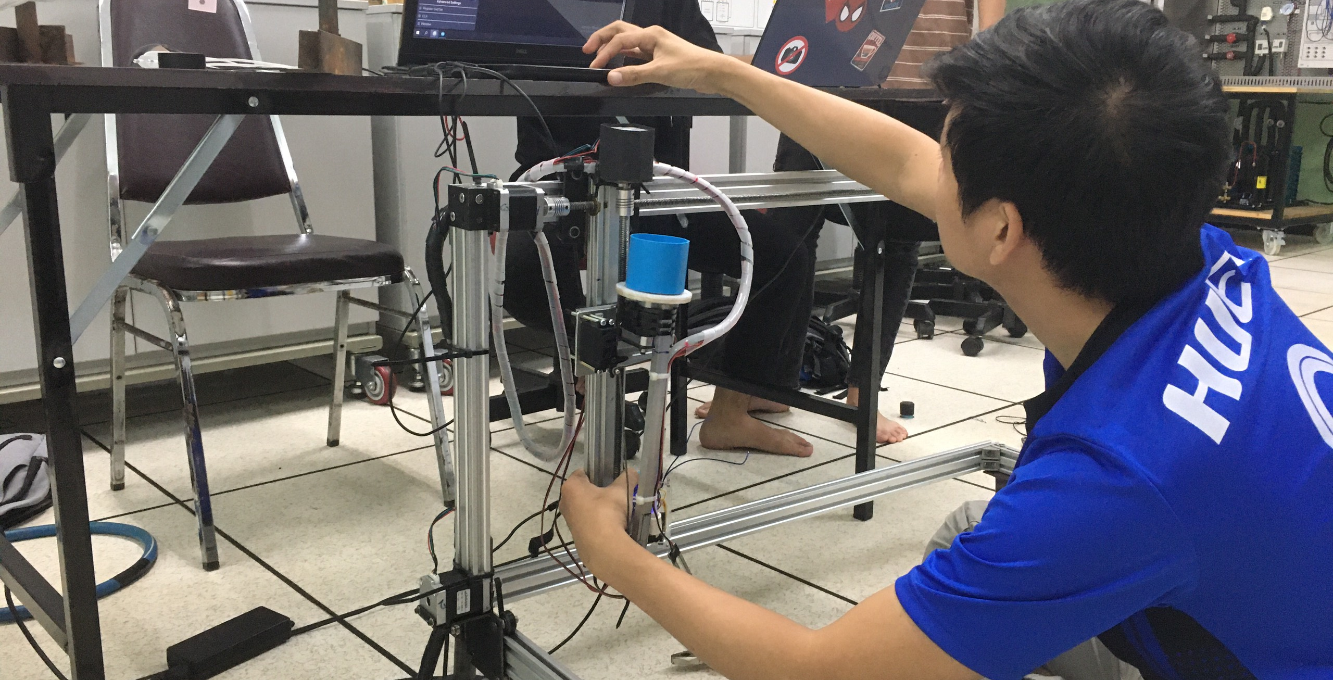
EQUIPMENTS AND METHOD
EQUIPMENTS AND METHOD
Let's see how we do it …

Slide 18
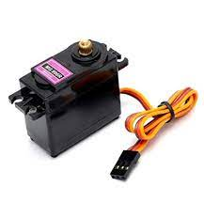
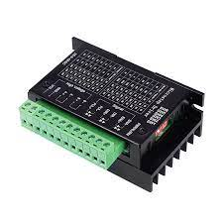
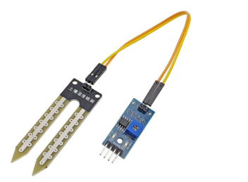
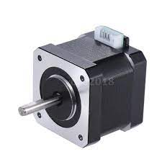
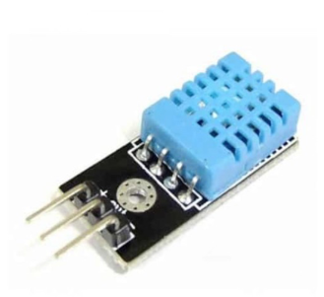
EQUIPMENT
Soil Moisture Sensor
TB6600 Stepper Motor Driver
Servo MG996R
EQUIPMENTS AND METHOD
MATERIALS AND METHOD
Step Motor Nema 37
DHT11 Temperature

Slide 19
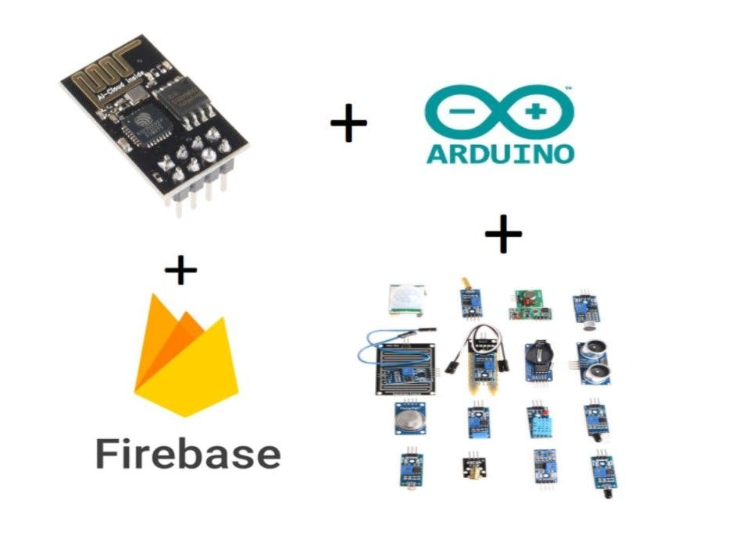

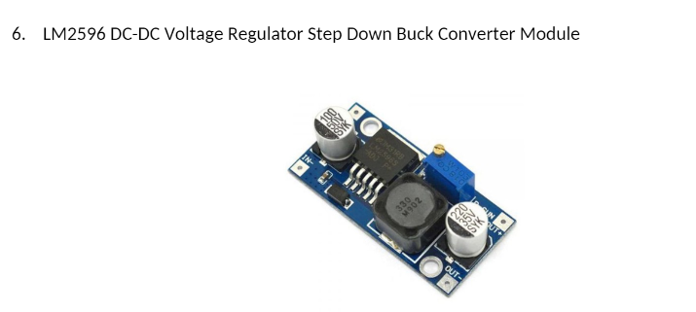
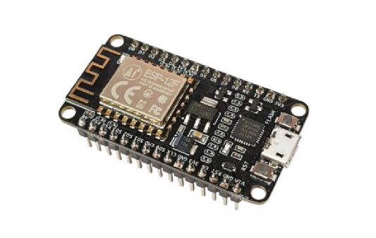
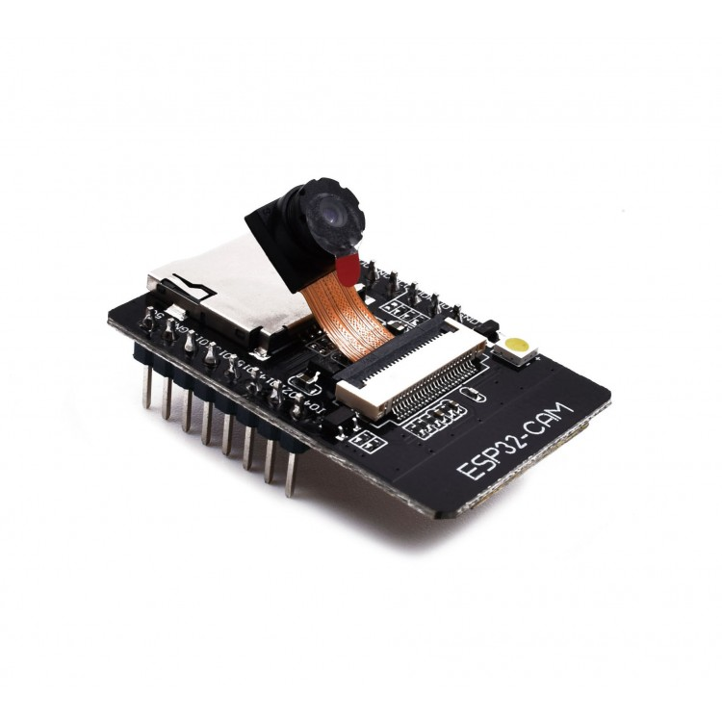
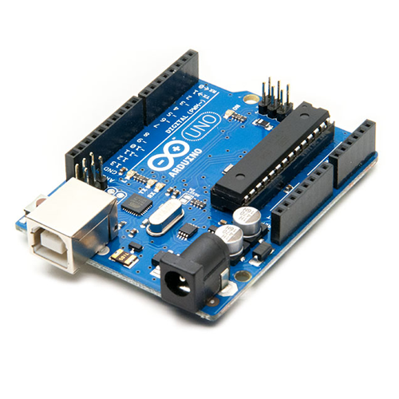
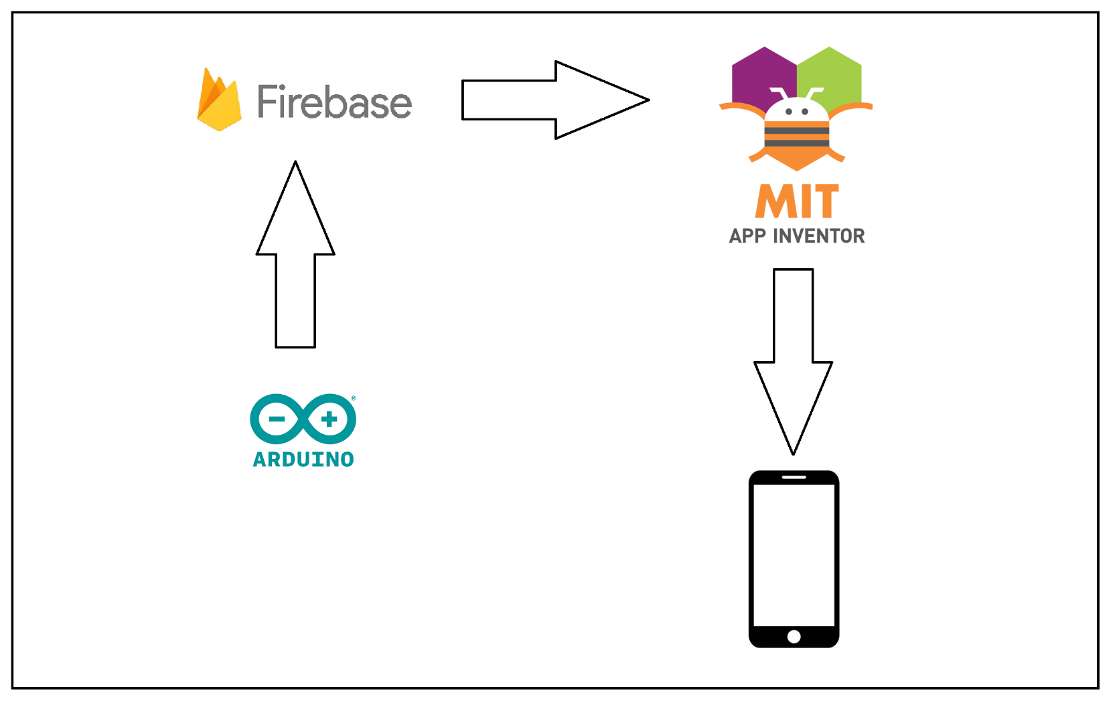
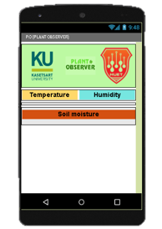
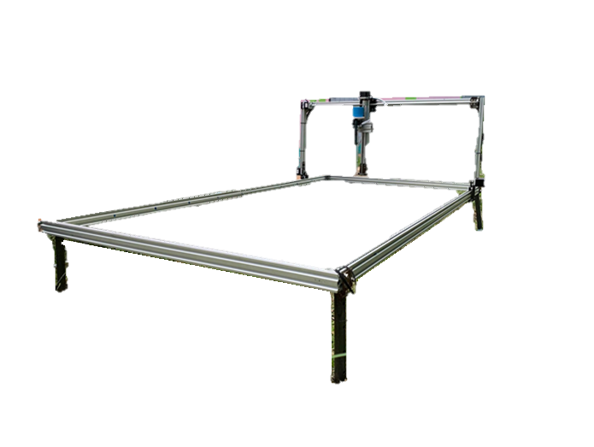
EQUIPMENT
LM259 ModuleWireless Connectivity
ESP8266
Module ESP32-CAM
EQUIPMENTS AND METHOD
Arduino UNO

Slide 20

OVERVIEW
EQUIPMENTS AND METHOD
EQUIPMENTS AND METHOD
Wire Connect
Here is an overview of our ideas and implementation to achieve our requirements
Wireless Connect

Slide 21
MAKE IT FASTER AND SMOOTHLY
EQUIPMENTS AND METHOD
ORIGINAL
DEVELOPED

Slide 22
MAKE IT FASTER AND SMOOTHLY
EQUIPMENTS AND METHOD
ORIGINAL
DEVELOPED

Slide 23
MAKE IT FASTER AND SMOOTHLY
EQUIPMENTS AND METHOD
MATERIALS AND METHOD
ORIGINAL
DEVELOPED

Slide 24
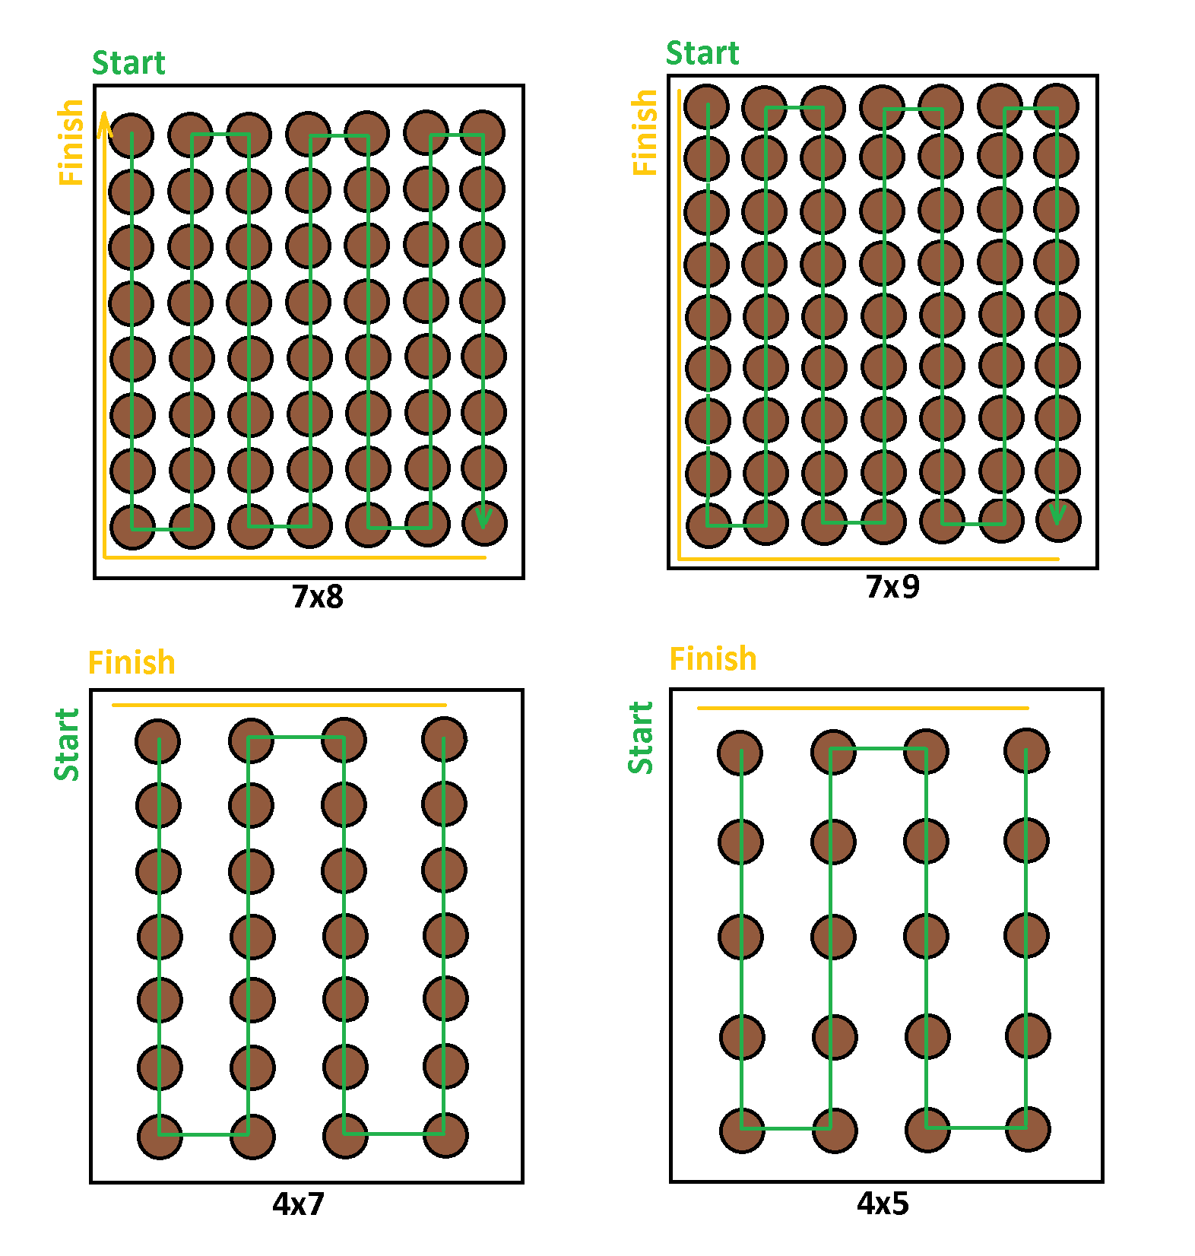
PLANTING MODE
Mode 1
Mode 2
EQUIPMENTS AND METHOD
Mode 3
Mode 4

Slide 25

AUTOMATIC WATERING PROCESS
Grow
Get time
False
If time = 5h
or time = 17h
True
set_day = set_day + set day
Water
Grow
Moisture meters
True
EQUIPMENTS AND METHOD
False
False
If leaf = 0
If moisture > normal
True
Counting leaves
Get day
False
True
If day > set_day

Slide 26
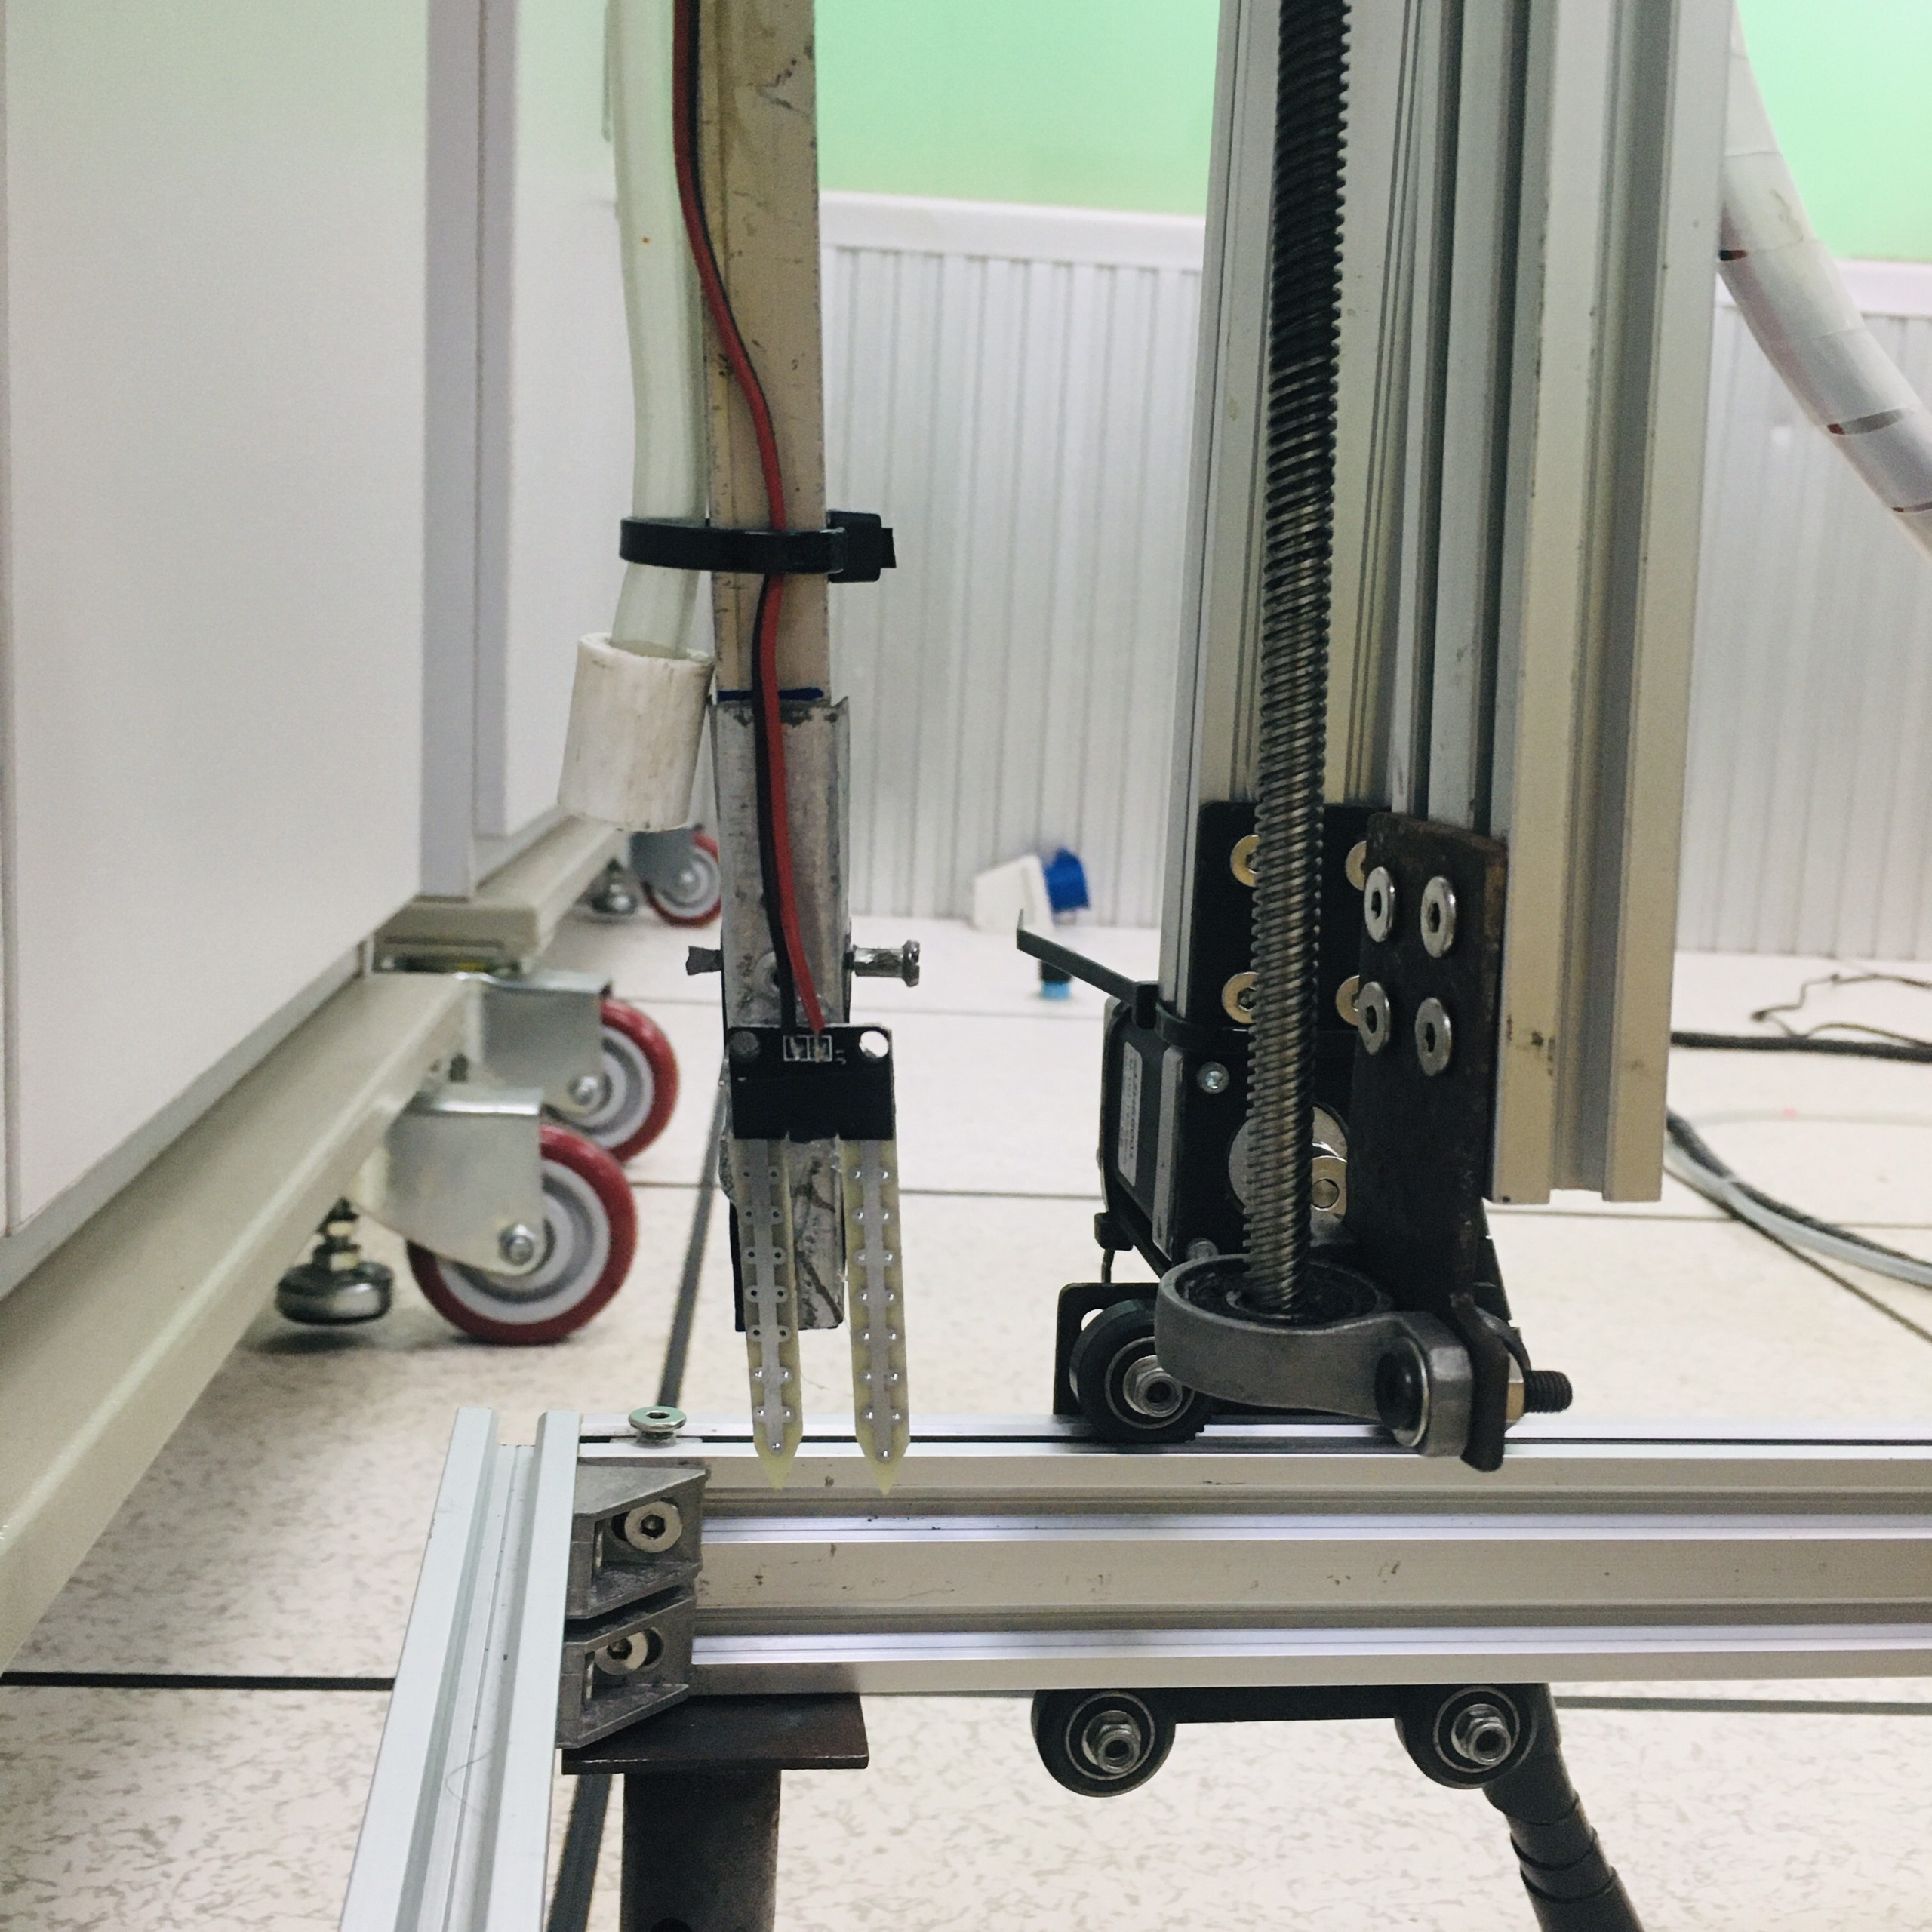
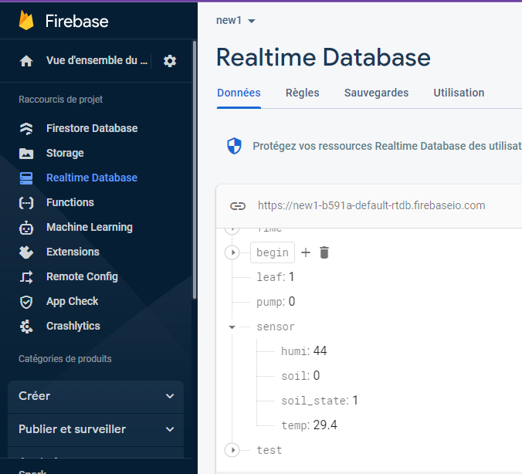
AUTOMATIC WATERING PROCESS
EQUIPMENTS AND METHOD

Slide 27

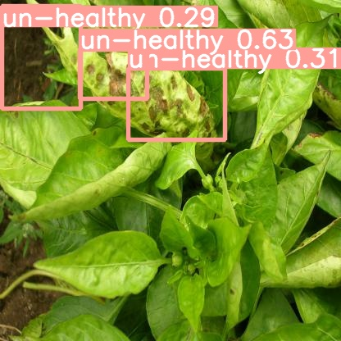
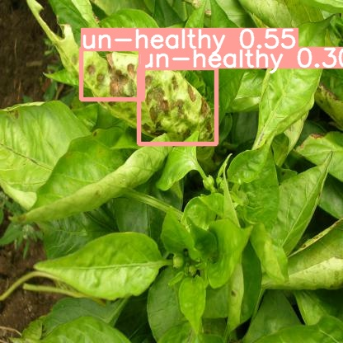
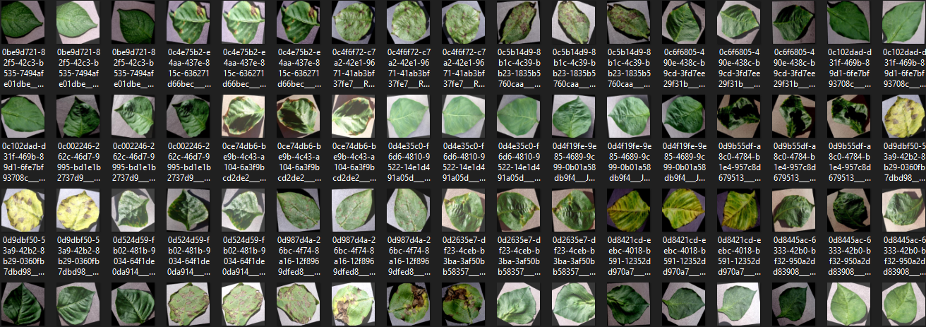

DISEASE LEAVES
DETECTION
EQUIPMENTS AND METHOD

Slide 28
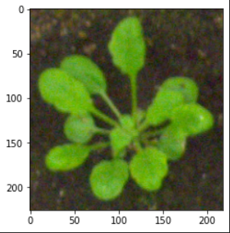
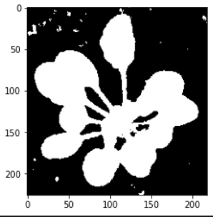
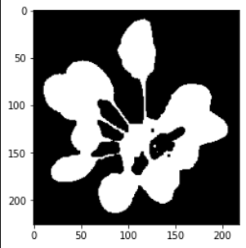
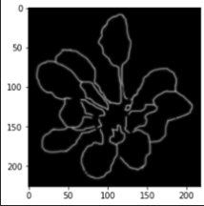
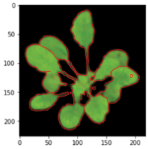
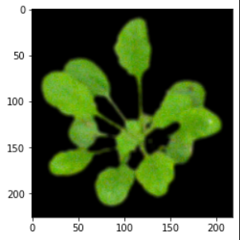
COUNTING LEAVES
Image processing
EQUIPMENTS AND METHOD

Slide 29
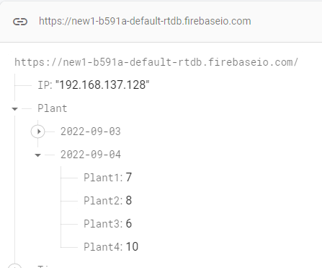
COUNTING LEAVES
Image processing
EQUIPMENTS AND METHOD

Slide 30
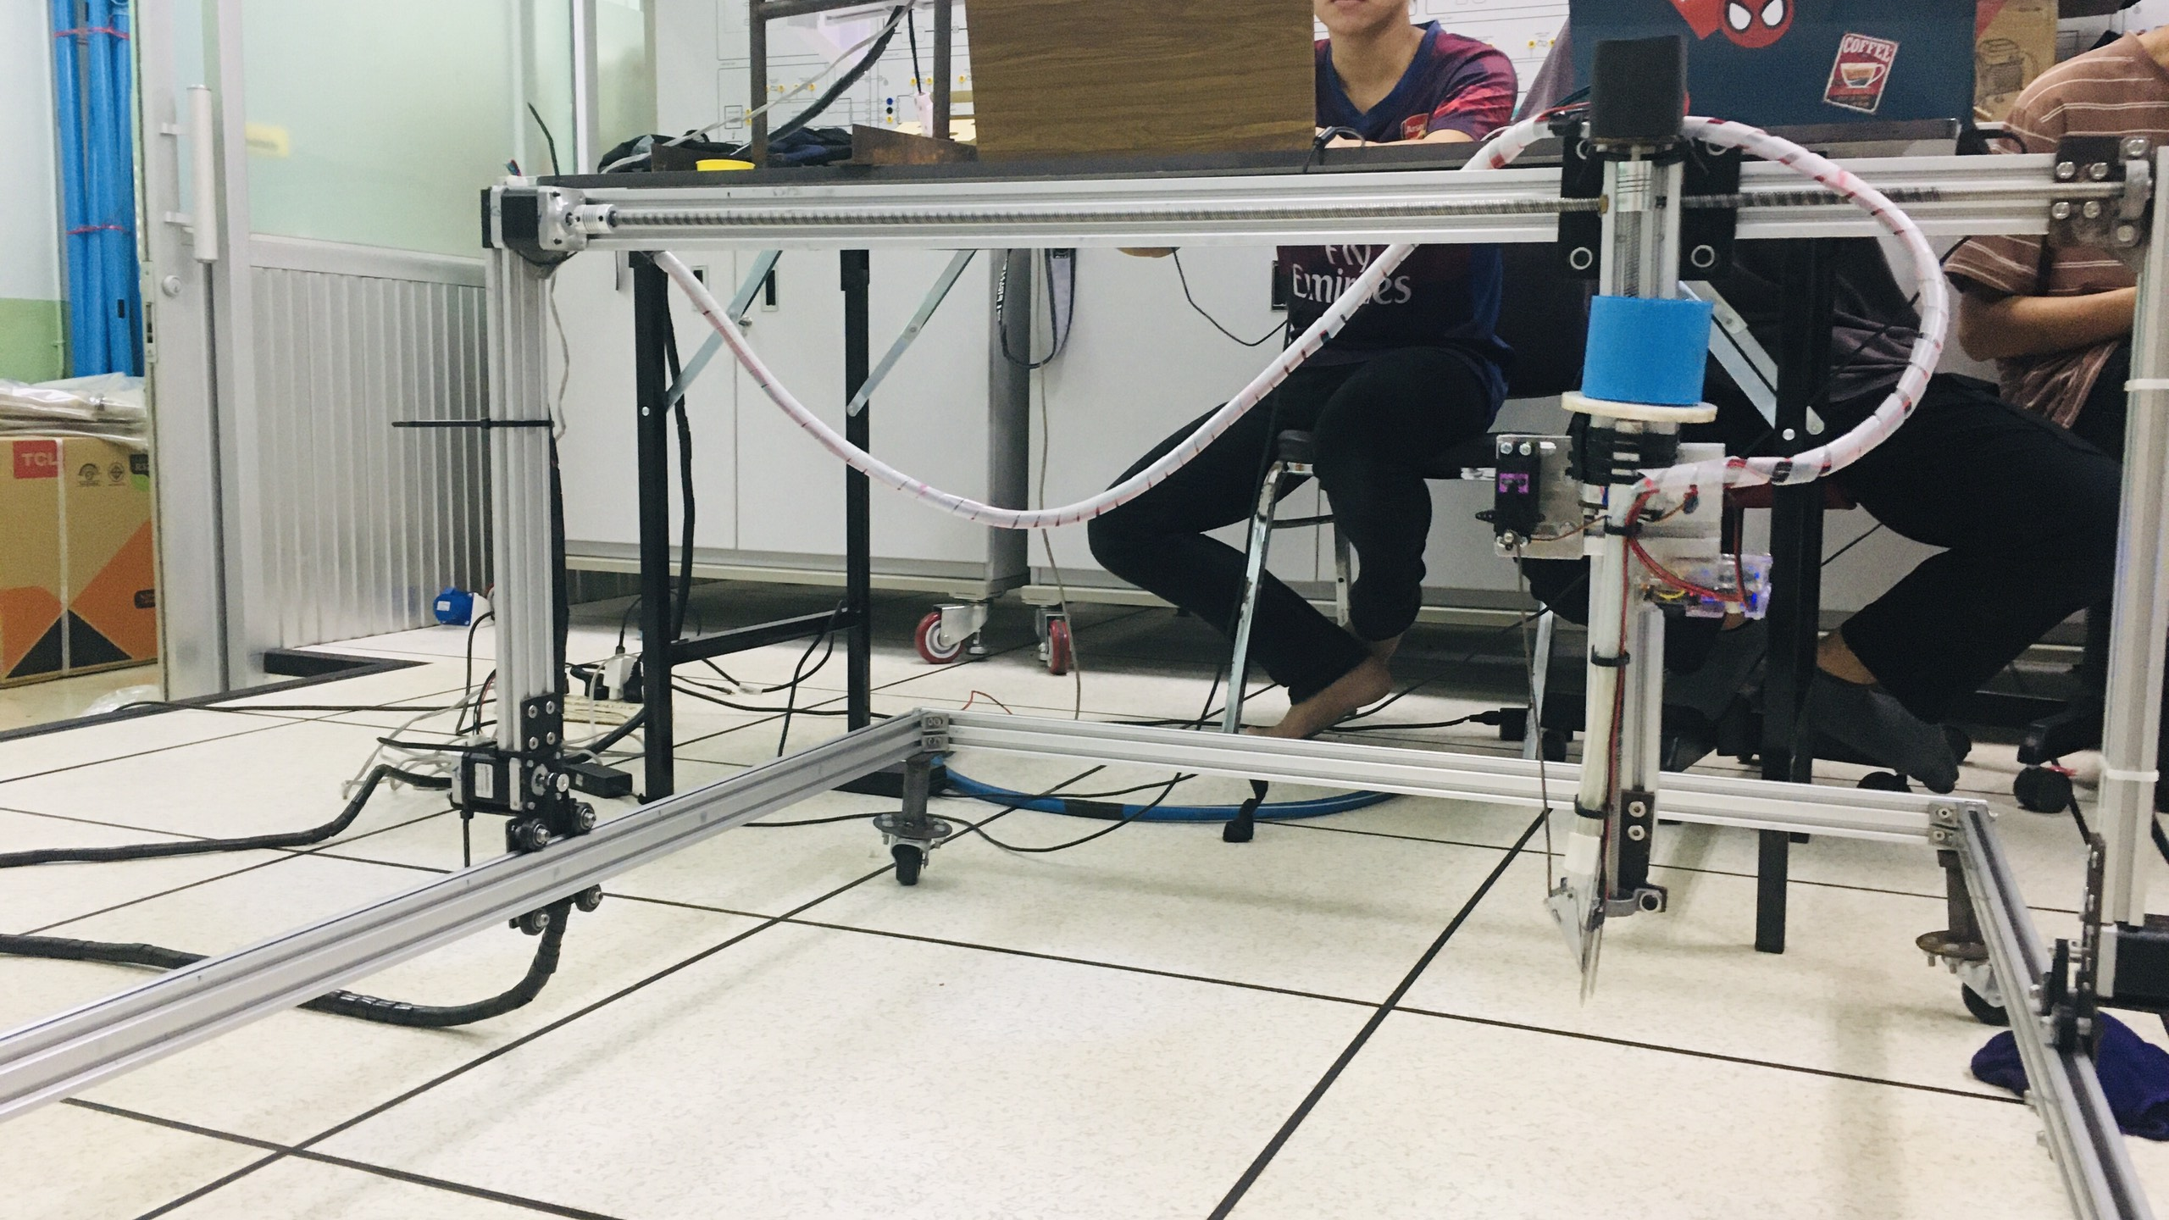
RESULT
Let's see what we have achieved

Slide 31
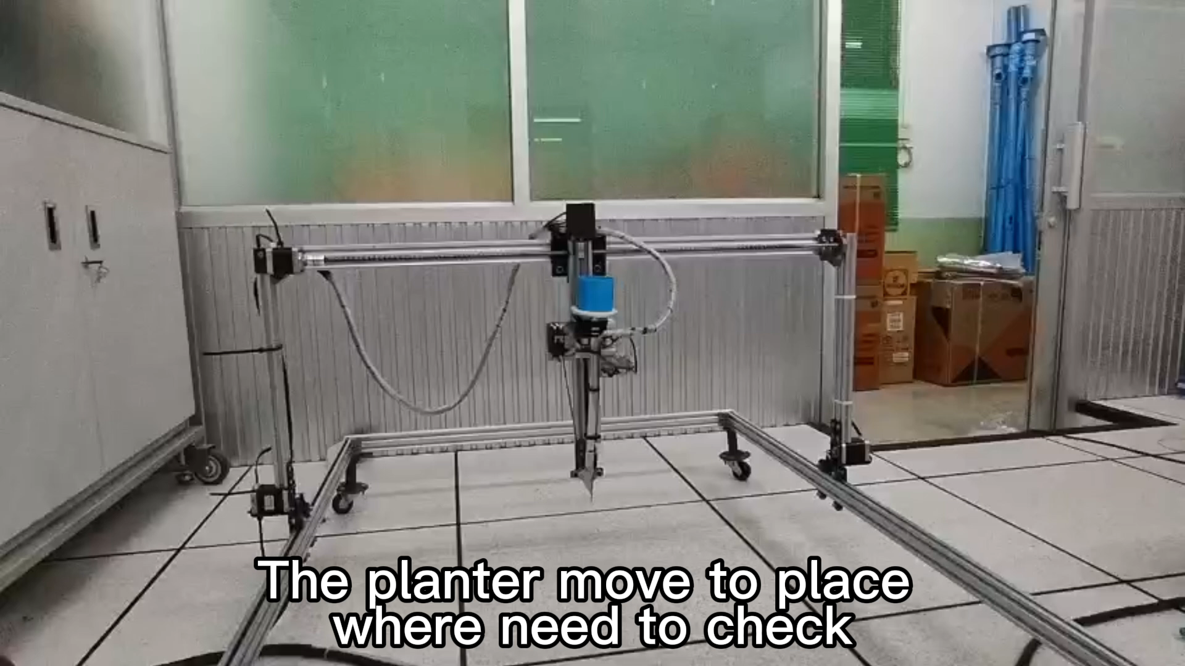
How did the planter work ?
RESULT

Slide 32
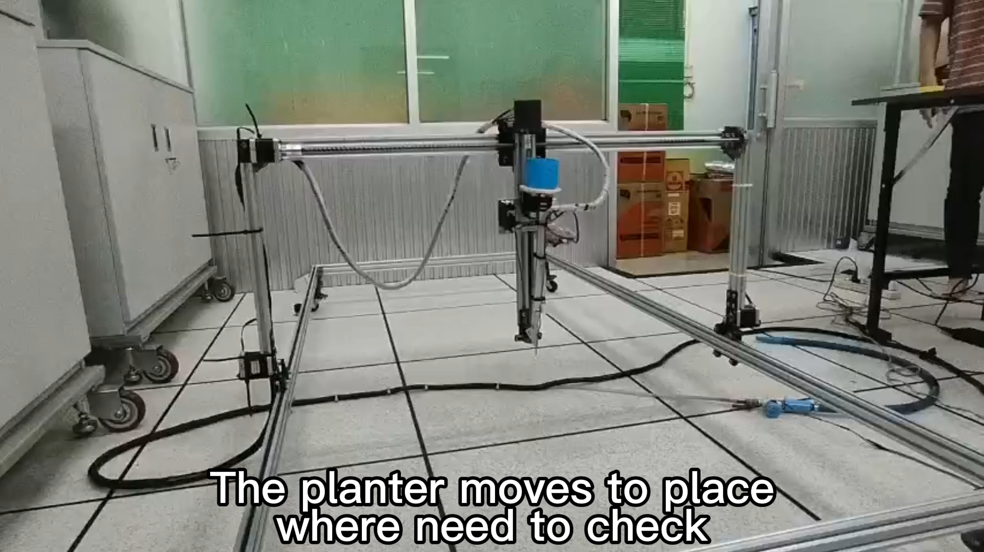
How did the planter work ?
RESULT

Slide 33
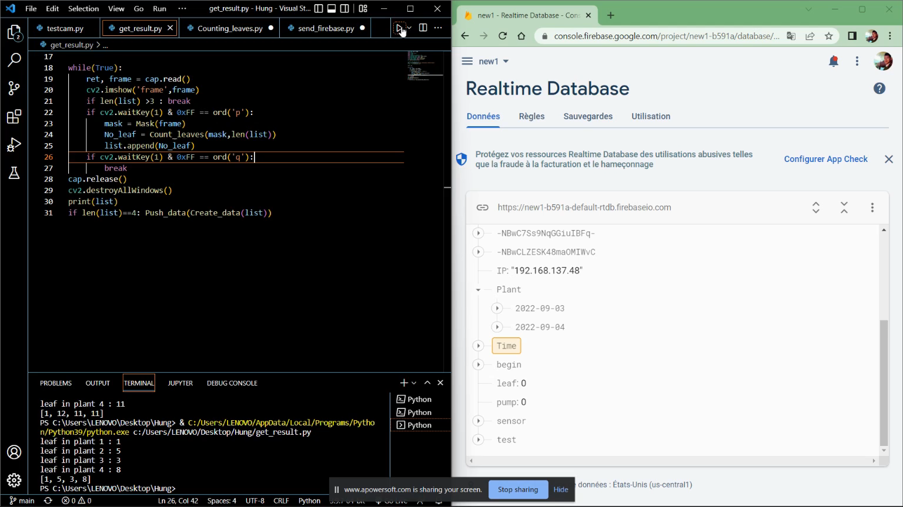
Counting leaves
RESULT

Slide 34
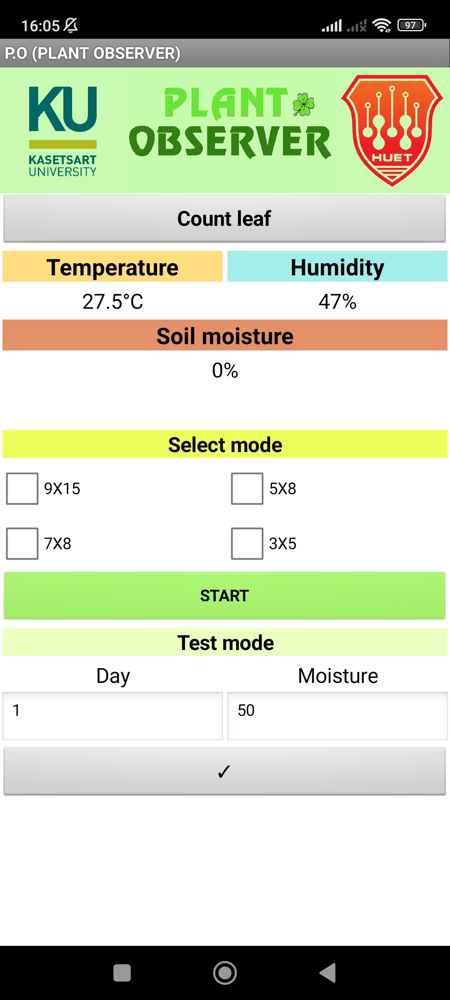
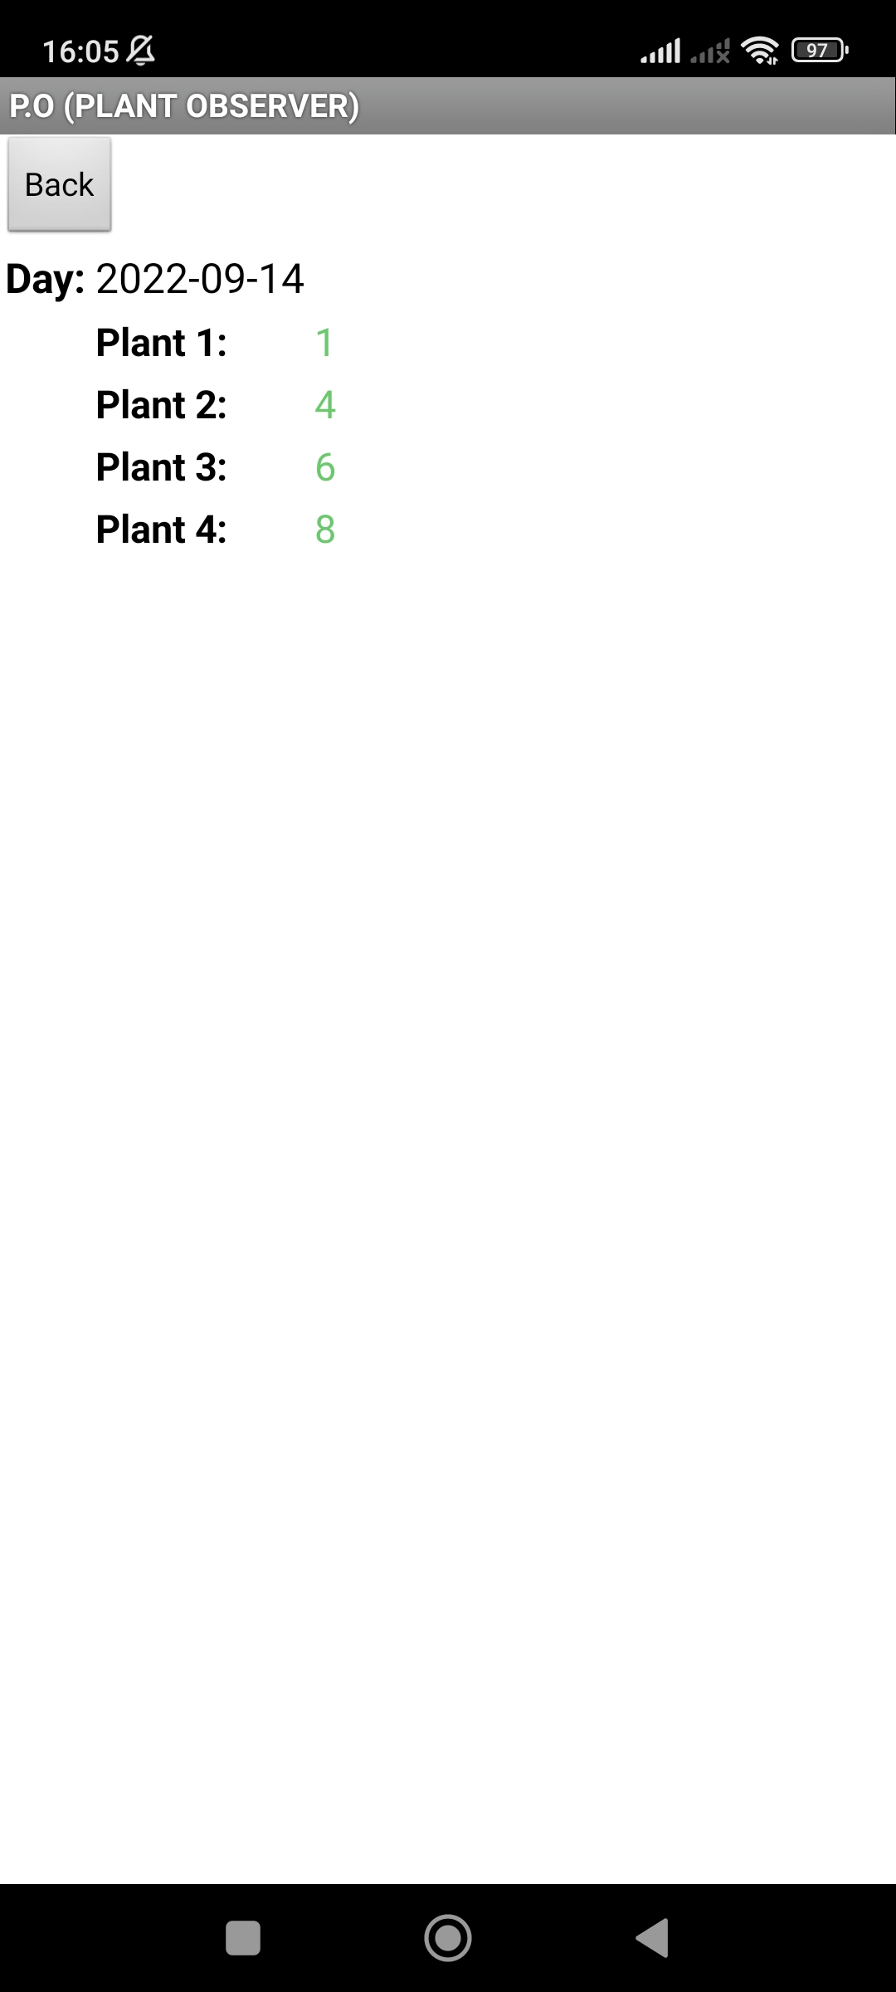
PLANT OBSERVER APP
RESULT

Slide 35
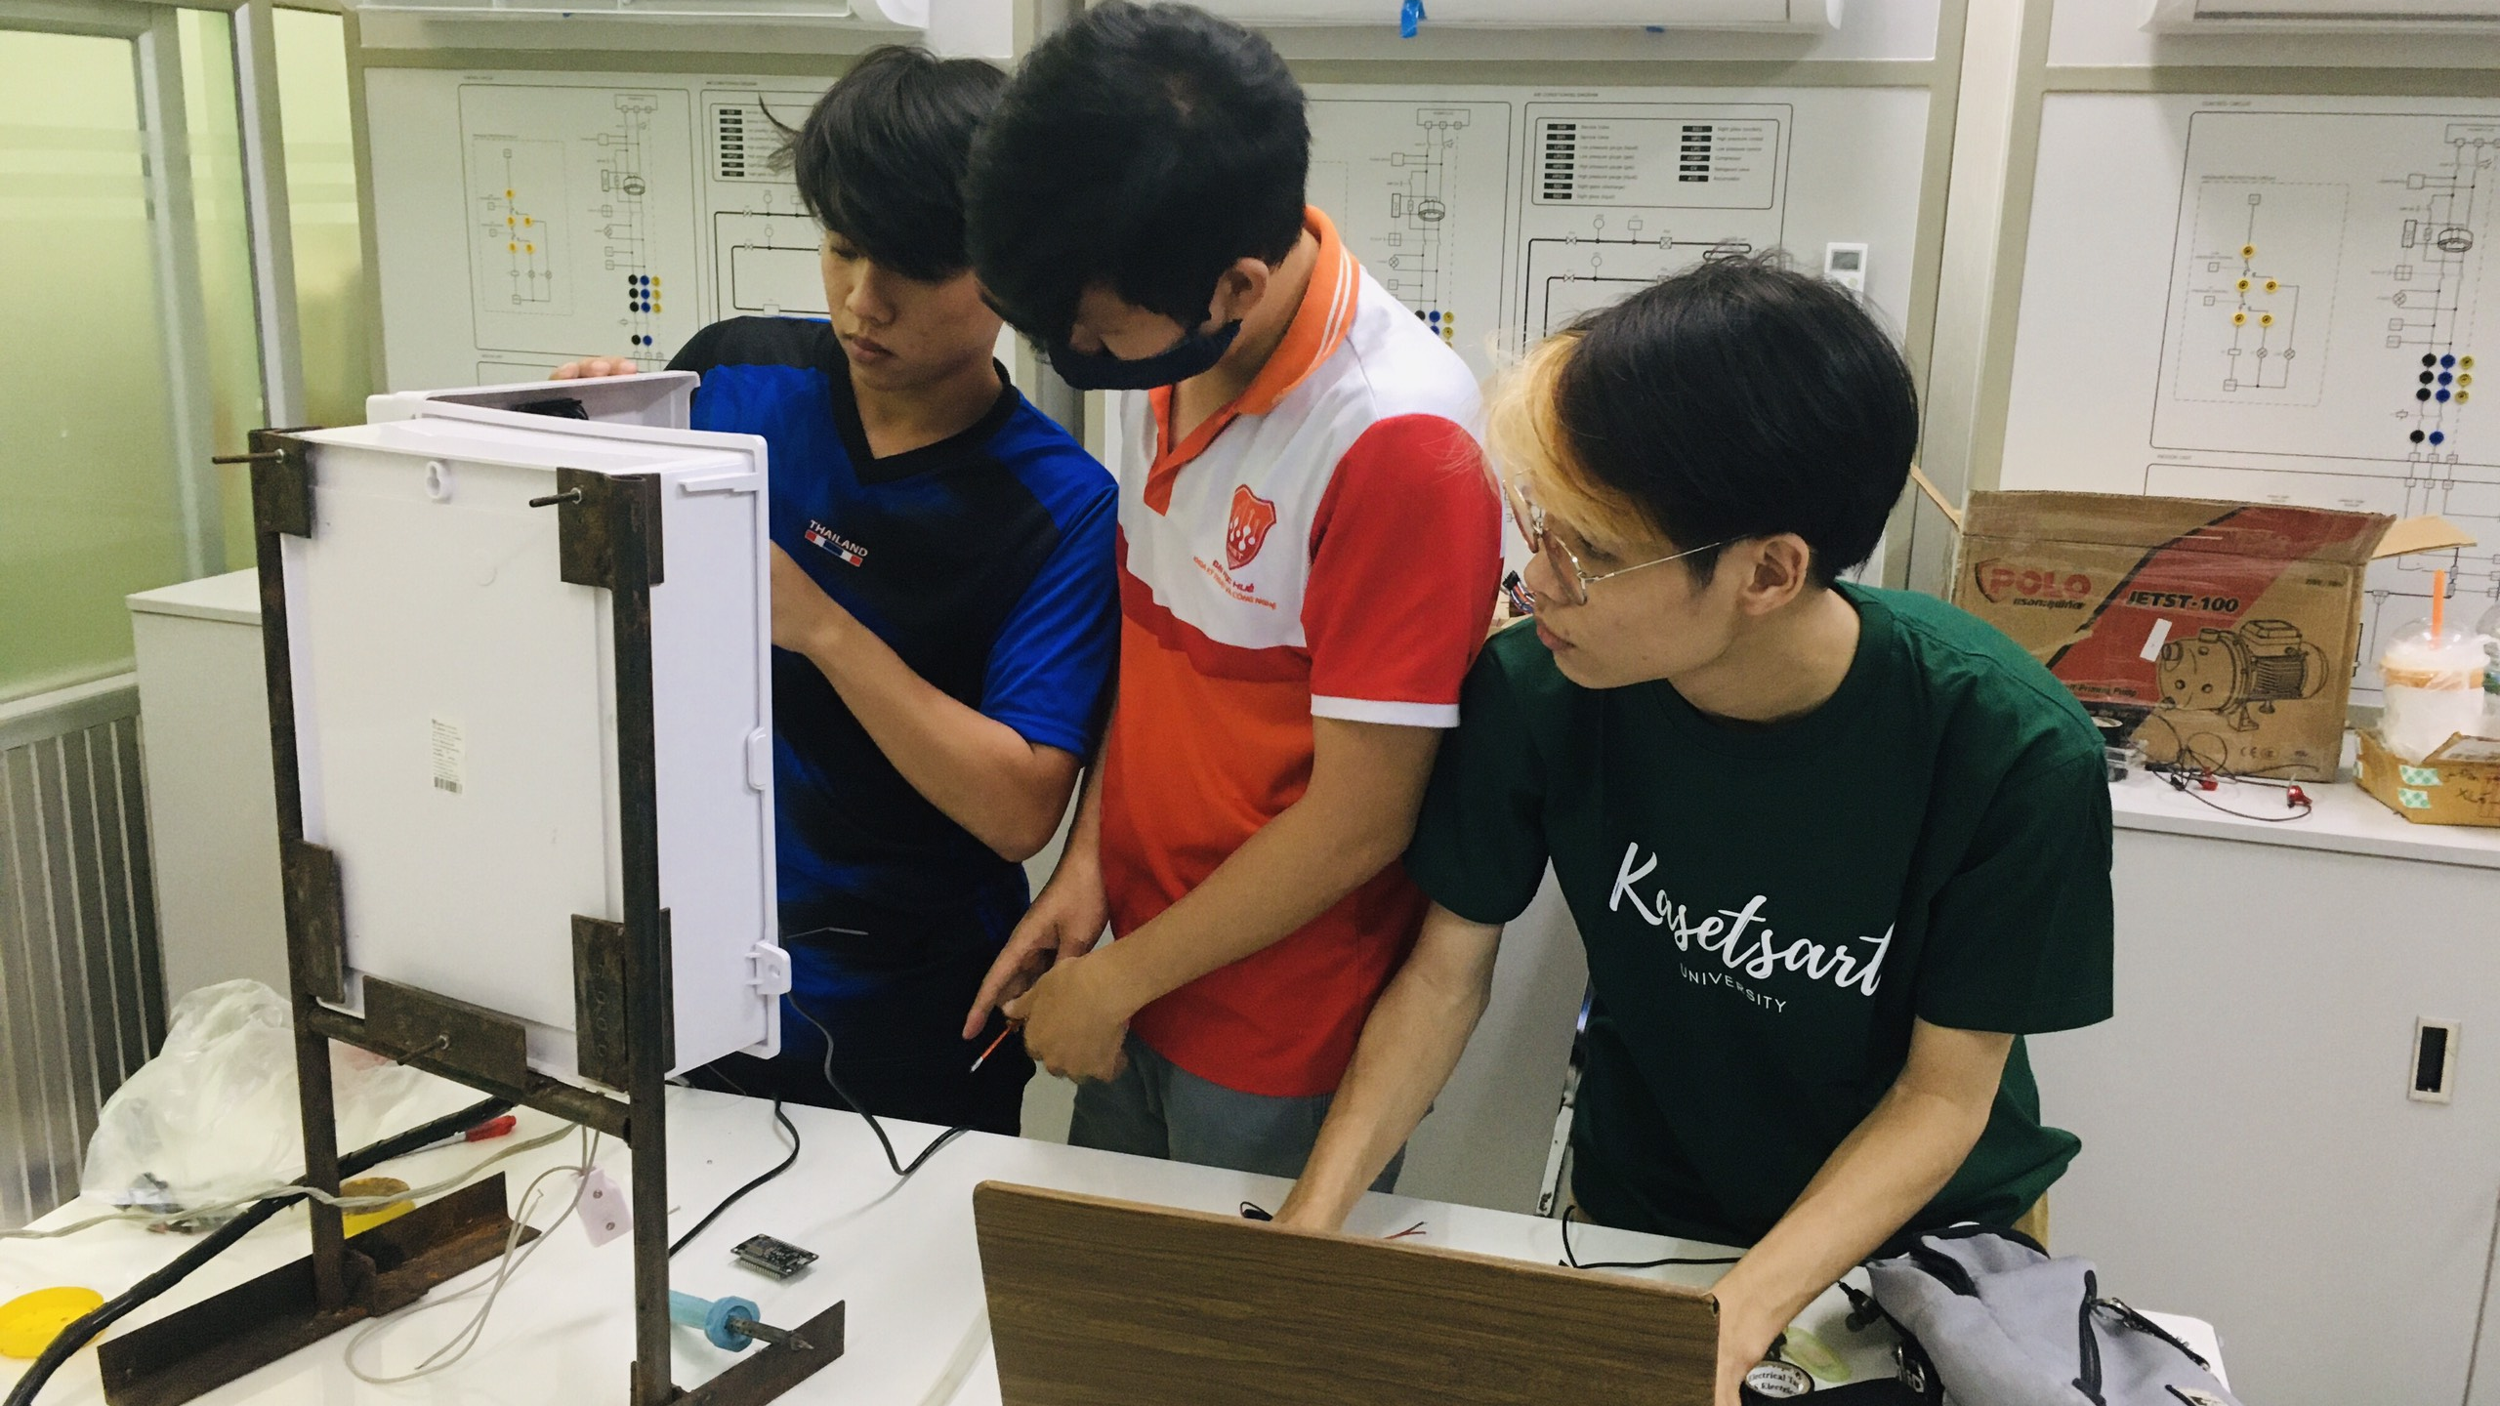
CONCLUSION

Slide 36






CONCLUSION
WHAT DID WE ACHIEVE ?
Improved:
Improve the speed and make it run smoothly
Developed:
To set the planting mode
To make it work automatically from an mobile application
To get planting information: humidity, temperature and soil moisture
To count leaves.
CONCLUSION
X Unfinished:
To detect unhealthy leaves

Slide 37

FUTURE WORK
What should we do in the future ?
One may use the camera to measure tree height or leaf size.
One may develop the process or system to prevent pests.
One may develop the nutrient delivery system
CONCLUSION

Slide 38
REFERENCES
[1] The Prototype of Automatic Water Sprinkle with Soil Moisture Sensor Based on ATMega 8535.
https://www.researchgate.net/publication/340025269_The_Prototype_of_Automatic_Water_Sprinkle_with_Soil_Moisture_Sensor_Based_on_ATMega_8535
[2] Yolov5 training model
https://github.com/ultralytics/yolov5
[3] Dataset for detecting unhealthy leaves
https://universe.roboflow.com/samkeun/plantdoc-yolov5-custom-training/dataset/2
CONCLUSION

Slide 39
REFERENCES
[4] Arduino IDE
https://www.arduino.cc/
[5] ESP32 cam
https://www.bing.com/th?id=A3c002c4642dfbe194e255ccbb663affd&w=148&h=148&c=7&o=6&pid=SANGAM
[3] Fambot
FarmBot | Open-Source CNC Farming
CONCLUSION

Slide 40
THANK YOU
Final presentation
Day 16.09.2022
THANK YOU
Thank you for participating

